Slide 1


Commercial Analysis
Final Presentation
Team 5
Prepared for: Inside Airbnb

Slide 2
CONTENTS
Implementation Status
Mid-Term Recap
The Process Schematic
Dashboards
Executive Summary
Property Portfolio
Property Statistics
Commercial Segmentation
Licensing Analysis
Appendix

Slide 3
Commercial Metrics – Implementation Status
Commercial Metrics
All the commercial metrics have been successfully incorporated into the dashboard with the following granularities
 |  |  | GEOGRAPHICAL GRANULARITY IMPLEMENTED
# | Metric | Detail | USA | ITALY
1 | Property Type | Distribution of entire homes % vs rest | STATE – COUNTY – CITY - ZIP CODE | REGION – PROVINCE – CITY
2 | STR vs LTR | Distribution of short-term/long-term rentals – Indication of additional regulations in certain regions | STATE – COUNTY – CITY - ZIP CODE | REGION – PROVINCE – CITY
3 | Commercial Nature | Segmentation of Airbnb listings across Commercial, Semi-Commercial and Home-Sharing based on established rules | STATE – COUNTY – CITY - ZIP CODE | REGION – PROVINCE – CITY
4 | Multiple Listings % | Identification of hosts with property portfolios based on entire homes | STATE – COUNTY | REGION – PROVINCE
5 | Renting Frequency | High frequency of rent potentially points towards a commercial operation | STATE – COUNTY | REGION – PROVINCE
6 | Licensed % | Distribution of licensed properties – Algorithm based – City - Level | CITY | CITY
We utilized the provided key commercial metrics and created algorithms to close any data gaps

Slide 4
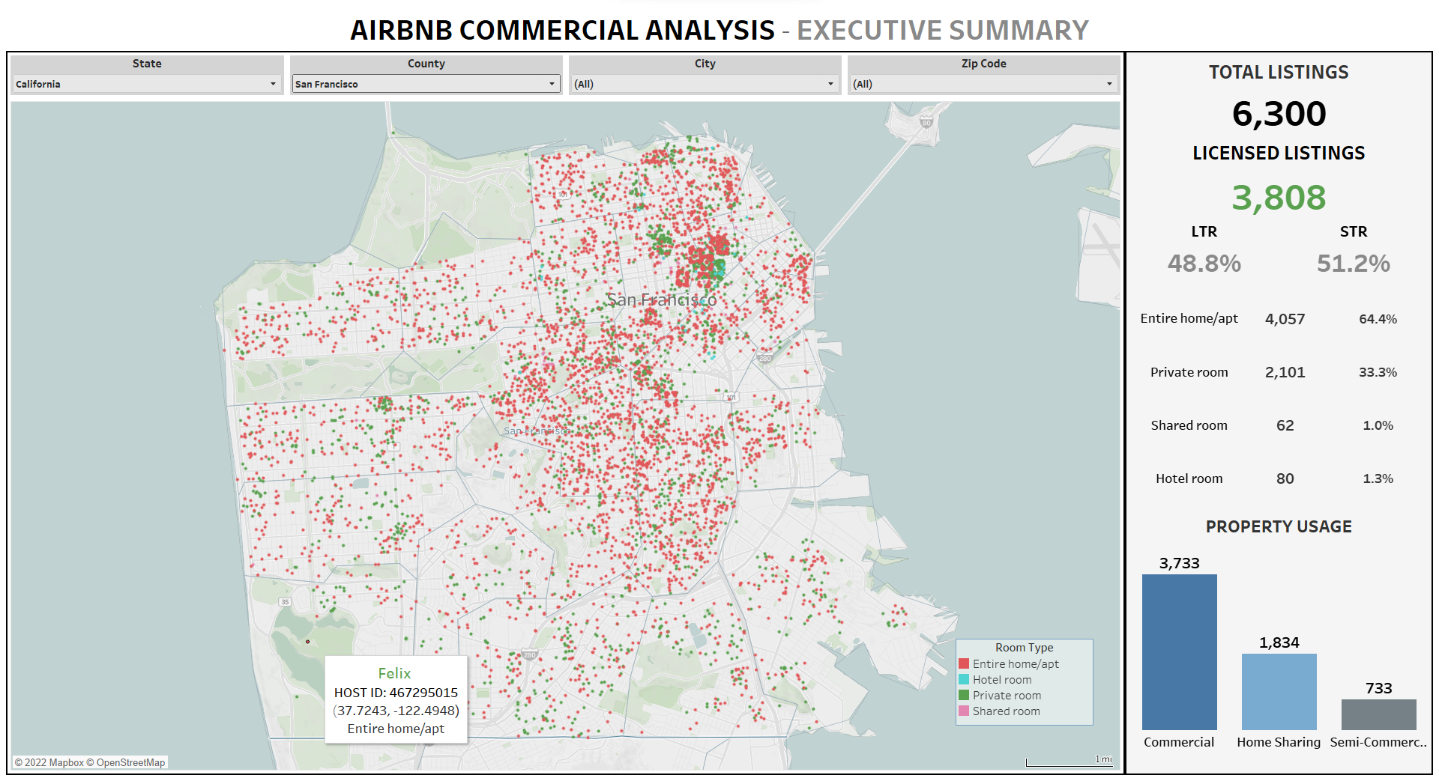
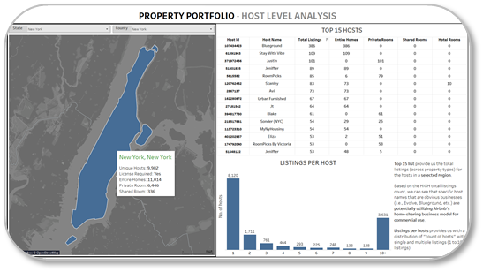
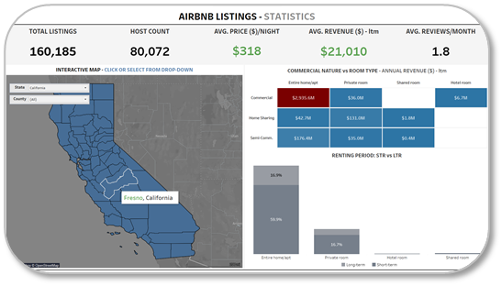
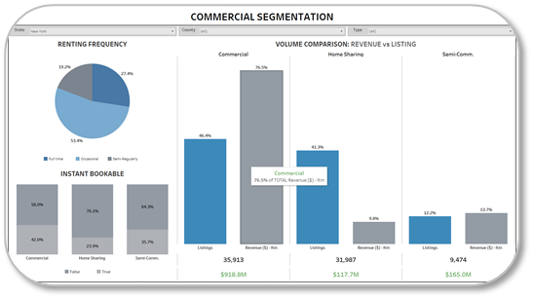
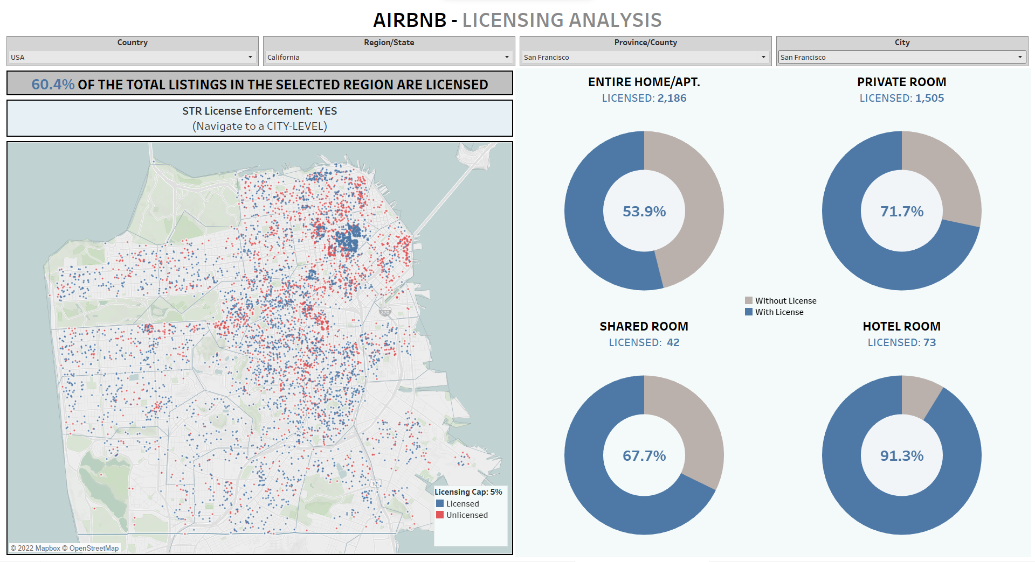


Mid-term Recap – Quick refresher on the dashboard updates
Overview
All dashboards have been updated as per our mid-term alignment: 1) Addition of licensing algorithm 2) Data for another country
1
EXECUTIVE SUMMARY
2
PORTFOLIO ANALYSIS
3
PROPERTY STATISTICS
4
COMM. SEGMENTATION
5
LICENSING ANALYSIS
DATA LEVEL
DATA LEVEL
DATA LEVEL
DATA LEVEL
DATA LEVEL
UPDATES:
- Addition of Italy Data
- Country-Level Filter
- Licensed Properties
UPDATES:
- Addition of Italy Data
- Country-Level Filter
UPDATES:
- Addition of Italy Data
- Country-Level Filter
UPDATES:
- Addition of Italy Data
- Country-Level Filter
FEATURES:
- Italy and USA data
- Licensing Map: Based on license cap
- Room-level info.
NEW
The tool incorporates 5 interactive dashboards with data from 2 different countries with different geographical hierarchies

Slide 5



The Process Schematic – Creating the final dashboards
Overview
User can replicate the following process for adding additional countries into the final dashboard
INSIDE
AIRBNB
PRE-PROCESSING
PYTHON FILE
CLEAN
FILES
Import
Second python script is used to merge the clean data files from different countries
USA.csv.gz
TEAM5_USA.ipynb
USA.csv
COUNTRY
TYPE 1
Pre-processing python code is used to clean and structure the data for dashboard use
TEAM5_MERGE.ipynb
Final_listings.csv
Final upload
to
Tableau
Import
ITALY.csv.gz
TEAM5_ITALY.ipynb
ITALY.csv
COUNTRY
TYPE 2
Geographical hierarchies like USA & Italy can currently be added to the final listings file using the illustrated process – ensuring tool scalability

Slide 6


Dashboard Scalability – Geographical Hierarchy
Overview
Countries have different geographical hierarchies which requires mapping to be used in a shared visualization tool
DASHBOARD GEO FILTERS:
The filters in the dashboards have been renamed to capture both types of hierarchy:
Level 1: Country
Level 2: Region/State
Level 3: Province/County
Level 4: City
Level 5: Zip Code
USA
ITALY
GEOGRAPHICAL FILTERS
GEOGRAPHICAL FILTERS
COUNTRY
STATE
COUNTY
CITY
ZIP CODE
COUNTRY
REGION
PROVINCE
CITY
ZIP CODE
Geographical
Hierarchy
This mapping gives us insight on adding more countries i.e., Scalability within the visualization tool based on geographical structure

Slide 7
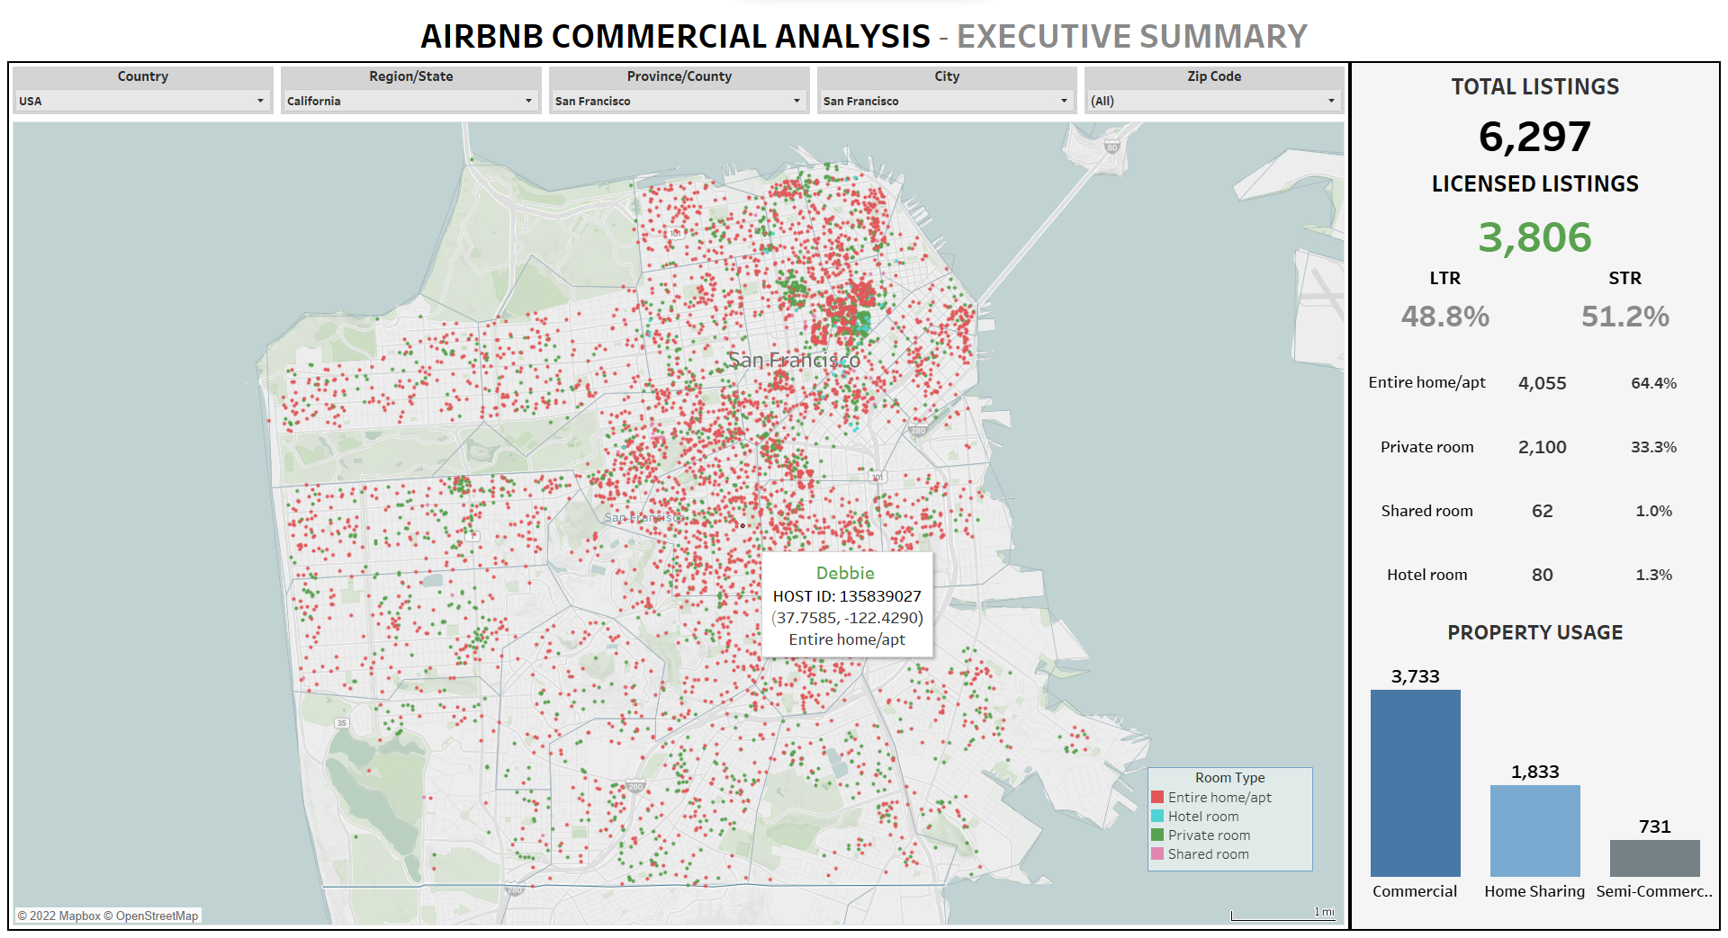
1. Executive Summary – Quick Look into the Commercial Metrics
Dashboard 1
COMMERCIAL METRICS:
All the metrics listed are updated as per the selection from the geographical filters
TOTAL LISTINGS – Count of property listings on Airbnb
LICENSED LISTINGS – Count of listings with a license (Green -> more than 5% of total properties licensed)
Short-term vs Long-term listings based on established rules: [<30 versus >=30 days]
Listing type helps us understand the distribution of entire homes/Apartments.
Property Usage – Distribution of listings based on aligned commercial segmentation ¹
GEOGRAPHICAL SELECTION:
Gives the user the flexibility to zoom-in and navigate to any region of interest from COUNTRY to ZIP CODE.
The filters automatically zoom-in and navigate to region of interest down to the Zip Codes.
We currently have city and zip code level data for 99.2% of the listings for USA.
Commercial, Semi-Comm. & Home-sharing definitions have been created after alignment with the sponsor - Appendix
The EXECUTIVE SUMMARY is designed to give a brief overview of the tool and the different commercial metrics to a new user
¹ We had alignment with the sponsor on our approach for segmenting the different listings – Based on “No of listings per host”

Slide 8
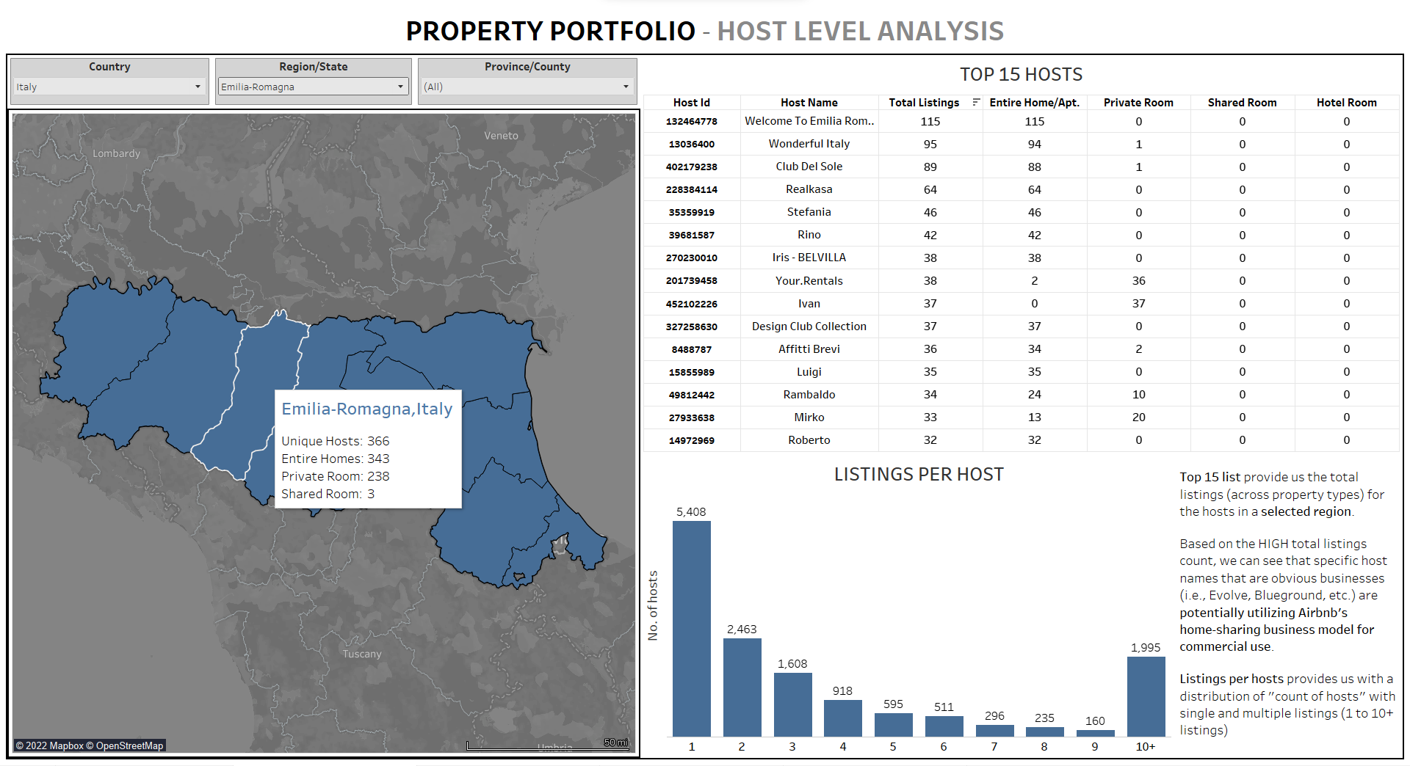
2. Property Portfolio – Host-level data
Dashboard 2
HOST METRICS:
TOP HOSTS – Provides the user with a list of top hosts (Host name + Host ID Level) via count of “Total Listings”.
These metrics help the user determine the property usage i.e., purpose of listing – Commercial, Semi-Comm. or Home Sharing.
High count of “Entire Home” listing potentially points towards commercial usage.
`
TOOL TIPS:
Provides the user with granular host-level data
Potential Insights:
Region with high listings to host ratio
Region with high “Entire Home” listings per Host
Listings per host – Gives the distribution of hosts having single/multiple listings.
Potential Insights: Identification of region with high multiple listings hosts
This interactive map tooltips provides the user the freedom to hover over the region of interest to get information
PROPERTY PORTFOLIO helps us understand the dynamics of hosts and their property ownership across various regions

Slide 9
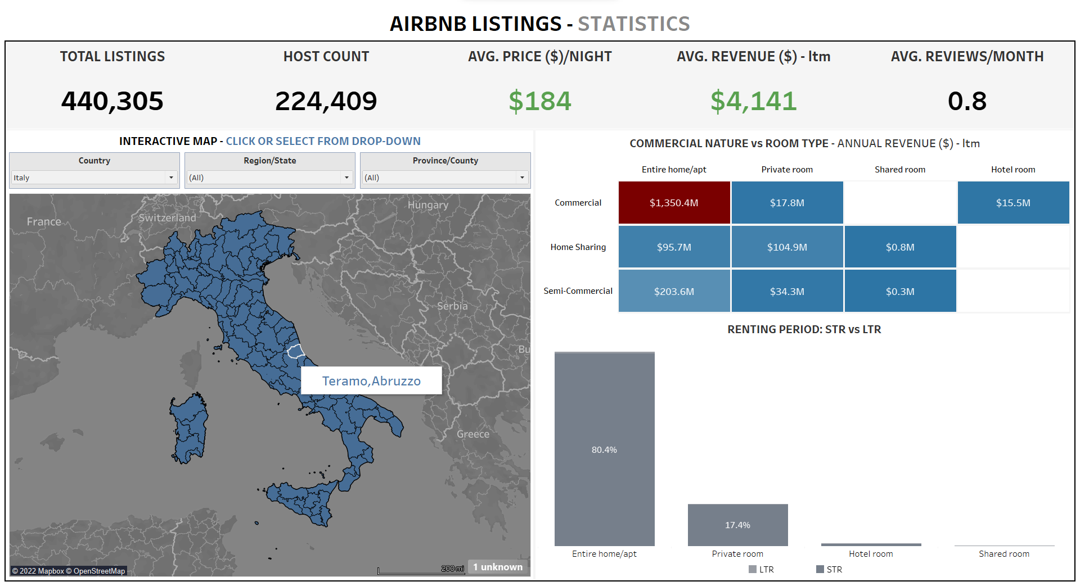
3. AIRBNB Listings – Property-Based Statistics
Dashboard 3
LISTING STATISTICS:
All the statistics listed are updated as per the selection from the geographical filters as well as clickable map UI.
HOST COUNT – Total hosts in the region (Country, State or County)
AVG PRICE – Average cost of stay per night for a listing (USD)
AVG. REVENUE – Average annual revenue generated from a property listing (USD)
This interactive map provides the user the freedom to click over the region of interest to get information across visualizations
COMMERCIAL NATURE vs ROOM TYPE – Gives us an annual revenue (USD) matrix
Potential Insight –Revenue generated through “COMM - entire homes/apt.”
LISTINGS dashboard gives us statistics (country, county, state-level) & annual revenue across the commercial segmentation

Slide 10
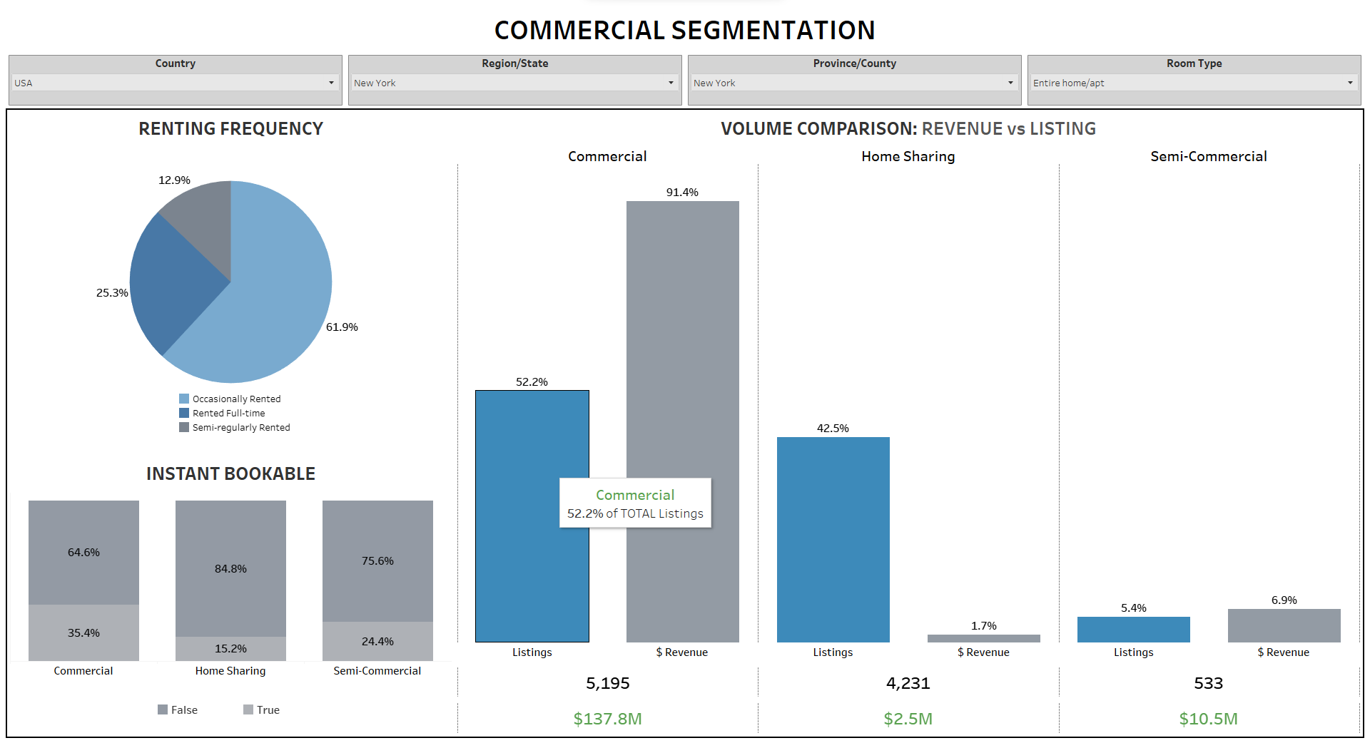
4. Commercial Segmentation – Renting Frequency & Revenue
Dashboard 4
Dashboard 4 filters on Country, State, County, and Room Type - enabling us to observe “Entire homes/apt.” data.
Instant bookable (bottom left) is a metric that has been used to indicate comm. property usage.
Potential Insight – ~65% of commercial properties in NYC have “Instant Bookable” feature.
The dashboard shows the distribution of listings based on how frequently they are rented for a specified geographic area (Country, State or County)
Volume vs. Revenue chart displays the percentage of listings (count) that are part of each commercial segmentation, and the percentage of revenue that each commercial segmentation generates.
Potential Insight – Commercial properties drive the bulk of the generated revenue for property types with ~50% of the total listings
COMMERCIAL SEGMENTATION dashboard shows rental frequency data and a comparison of listing volume vs revenue

Slide 11
5. Licensing Analysis – Deriving the licensing laws
Dashboard 5
GEOGRAPHIC SELECTION Licensing laws observed down to the CITY LEVEL
COUNT of Licensed listings
The map visual provides us with the licensed, unlicensed and exempt property listings based on the geographic selection
% of Licensed listings
ROOM TYPE
These visuals give the user the distribution of licensed vs unlicensed property for the same geographical selection at a room type level
Laws for licensing can sometimes vary based on property types hence, this gives the user additional flexibility for making that inference
The licensing laws have been derived using an algorithm i.e., “Cities are assumed to have licensing laws for STRs if count of licensed listings is greater than 5% of total listings in that city”
Two columns were created to identify the licensing requirement at a CITY-level based on % listings licensed (>5% and >10%)
LICENSING ANALYSIS gives the user an insight into the licensing laws enforced across the US at a CITY level and property type

Slide 12
Dashboard Walkthrough

Slide 13
Appendix

Slide 14



The Problem Statement
Business Case
The Problem – Airbnb hosts are potentially treating rentals as businesses by using their property portfolios as permanent holiday rentals. High number of commercial properties pushes the rent prices up for the locals.
Our Scope - Our project focuses on creating a hands-on visualization tool for a broad interested audience that highlights some of the key commercial aspects and statistics pertaining to the current listings of Airbnb across the United States of America.
Our Goal - Through our tool, we want to show the nature of Airbnb with metrics that differentiate "home sharing" vs more commercial use, e.g., entire home rentals, property portfolios etc.

Slide 15






PROJECT MEMBERS – TEAM 5
Adwaith Menon
(Sponsor Liaison)
Ayush Sinha
Darius Stallone
(Project Manager)
Jahnavi Adabala
Sanjana Argula

Slide 16
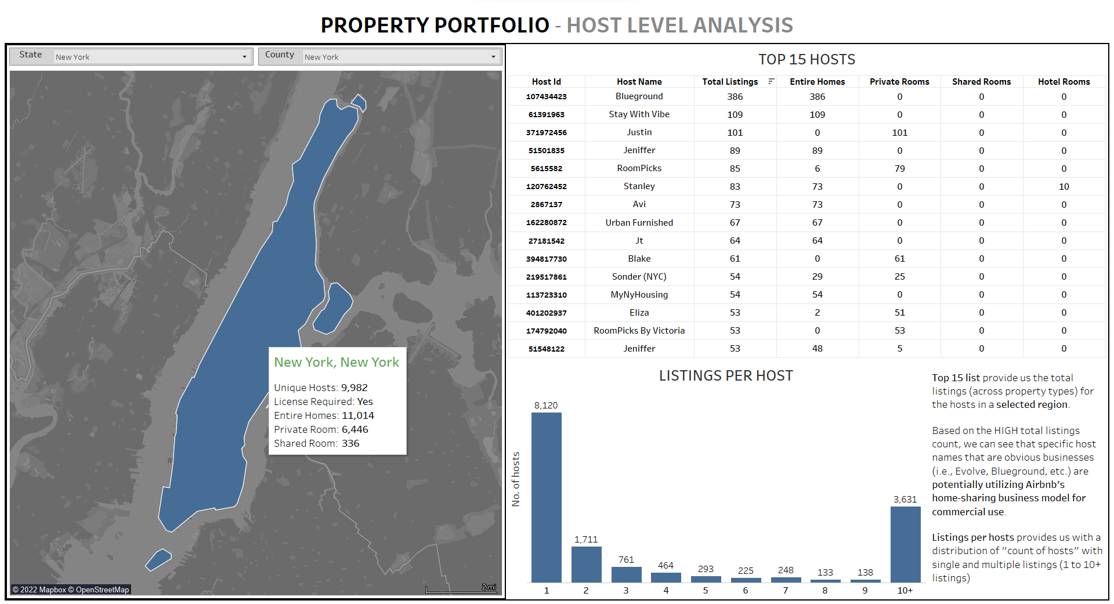
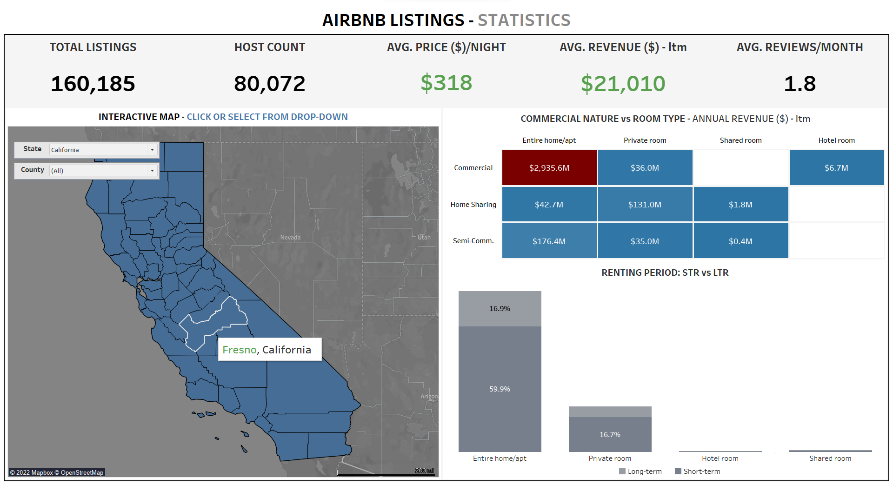
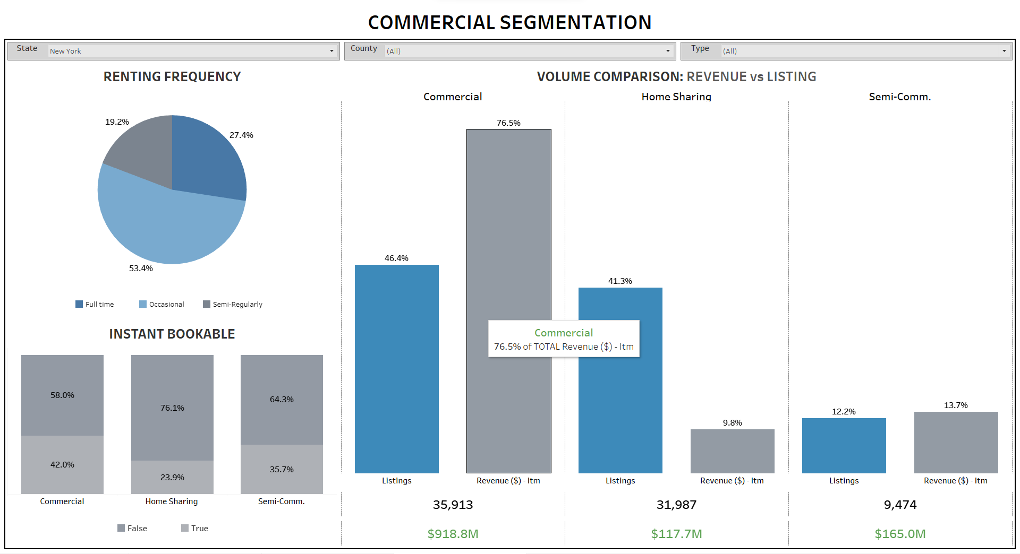
Dashboard Overview – Creating an intuitive flow for the end-user
Overview
Our goal is to design a comprehensive and user-friendly dashboard sequence that could assist any end user gain actionable insights on the commercial aspects of Airbnb
1
EXECUTIVE SUMMARY
5
LICENSING ANALYSIS
Executive summary - High-level insights into different commercial metrics at the deepest granularity
Dive deep Dashboards - Exploring data at different levels – (Host, Listings) for observing any potential commercial use
Algorithm Based Dashboards – Licensing Analysis
NEW DASHBOARD
2
PROPERTY PORTFOLIO
3
LISTING STATISTICS
4
COMM. SEGMENTATION
Our highly interactive dashboards gives users the flexibility for observing data at various granularities

Slide 17
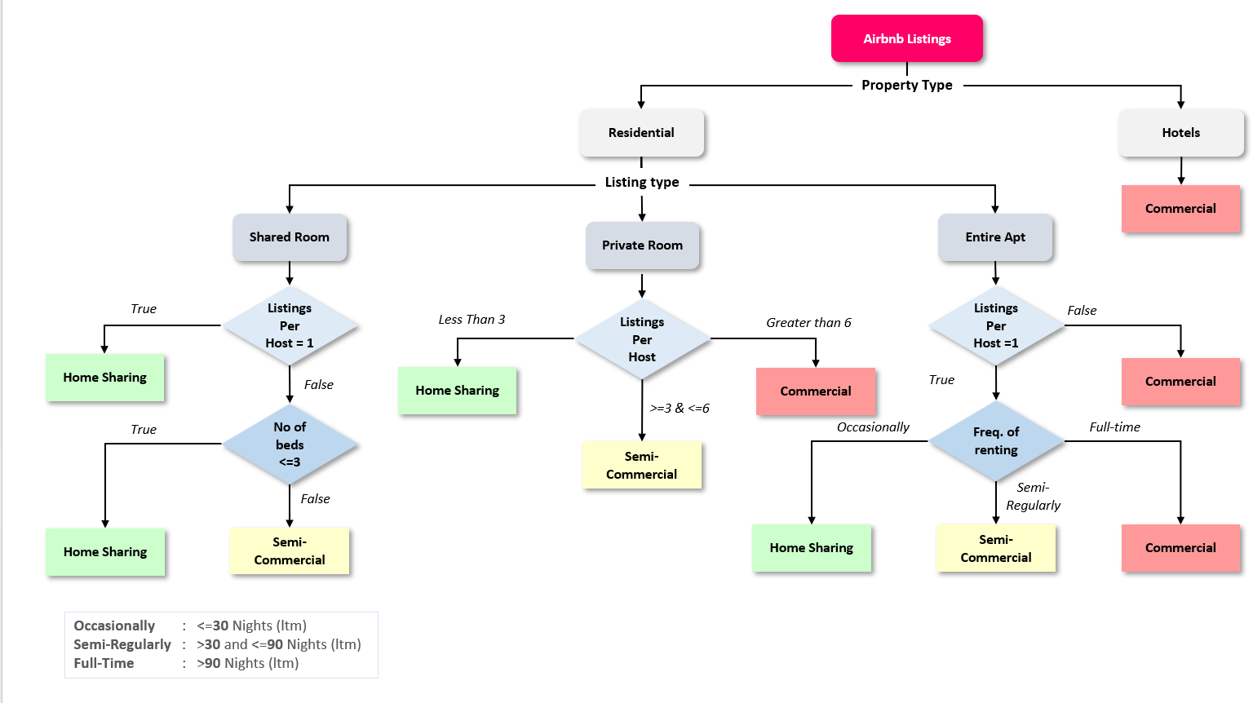
Commercial Segmentation

